Slide 1
Initial Capacity Assessment Sheet (ICAS)
&
Capacity Assessment Sheet (CAS)
Communication kit for suppliers.
Updated: 8 Dec 2010 for revision 01

Slide 2
Purpose of the Initial Capacity Assessment Sheet (ICAS) & Capacity Assessment Sheet (CAS)
The ICAS and CAS is used to verify and assure that the supplier's production system will be able to produce required customer declared volume stated in the RFQ.
Capacity is to be demonstrated in all production steps.
One ICAS/CAS is used for every part number.

Slide 3
ICAS/CAS – a part of the APQP.
APQP-reviews | Tool | GDP-milestones
Kick off meeting | ICAS
Product design | ICAS
Process design | ICAS
Industrialization review | ICAS/CAS | PPG (SPR) (PPAP)
Launch review | CAS | RG (R@R)
ICAS: In the first stages of the project/APQP a shorter version of the Capacity Assessment Sheet (CAS) is used, the Initial Capacity Assessment Sheet (ICAS). The ICAS is a self-assessment to be submitted to Volvo to verify that the supplier has a realistic capacity planning in place for the partnumber in question.
CAS: In the later stages of the project/APQP for the PPG and RG the full Capacity Assessment Sheet (CAS) is used. The CAS is the tool for documenting the SPR and R@R at the supplier site. It can be used either as a self-assessment by the supplier or a “live audit” tool by Volvo representatives.

Slide 4
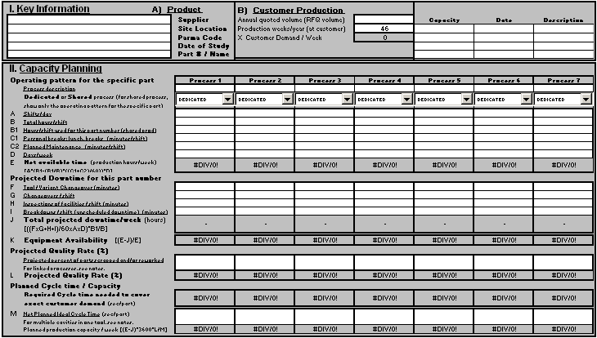
Initial Capacity Assessment Sheet (ICAS)
The purpose of the ICAS is to verify that the supplier has a realistic capacity planning in place for how to produce the required customer volume.
The ICAS is a self-assessment used by the supplier and then submitted to and approved by Volvo.
The ICAS consists only of 2 sections:
1. Key Information
2. Capacity Planning
One ICAS-file per partnumber is issued/used.

Slide 5
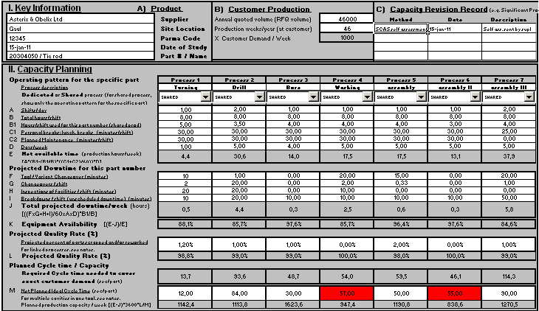
Initial Capacity Assessment Sheet (ICAS)
Filling in the file: The ICAS file has a second sheet named “ICAS user guide”. Please fill in the sections “1. Key Information.” and “2. Capacity Planning” according to the user guide. Fill in volume quoted in RFQ in cell “Annual quoted volume (RFQ)” in section “1. Key Information.” Volume value that should be used is volume in peak production year multiplied with 10% for fluctuations during the year.
Analyzing the result: In the attached example the row “M – Planned Ideal Cycle Time” is red/NOK for 2 of the assessed processes. (This is because the “Planned Ideal Cycle Time” is higher than the “Required Cycle Time needed to cover the weekly customer demand”). For the rest of the processes the result is green/OK. Actions by the supplier will be needed in these two red/NOK processes to get a totally green/OK result for the whole ICAS.

Slide 6
Initial Capacity Assessment Sheet (ICAS)
3. Examples of actions to make the red/NOK processes green and OK:
Supplier to implement actions to Decrease the “Planned Ideal Cycle Time” below the level of the “Required Cycle Time needed to cover the weekly customer demand”.
Supplier to dedicate more time to this part number in the assessed process by increasing the “A / B / B1 - Hours/shift used for this part number”.
Supplier to implement actions to reduce the planned/unplanned downtime (maintenance, breaks, setup, inspections, breakdown etc) in the assessed process.
Supplier to implement actions to increase “L - Projected Quality Rate (%)”
4. Final expected result: A totally green/OK ICAS = All production processes concerned has a capacity planning that is realistic and that will be able to produce the required/declared weekly customer volume for the concerned part number.

Slide 7
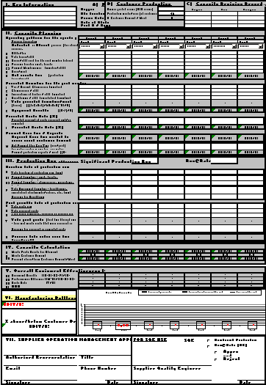
Capacity Assessment Sheet (CAS)
The CAS is the tool for documenting the SPR and R@R at the supplier site.
The CAS can be used either as a self-assessment by the supplier or a “live audit” tool by Volvo representatives.
The CAS consists of 7 sections:
1. Key Information
2. Capacity Planning
3. Production Run
4. Capacity Calculation
5. Overall Equipment Effectiveness (OEE)
6. Manufacturing Bottleneck
7. Supplier Operation Management Approval.
One ICAS-file is used per part number.

Slide 8
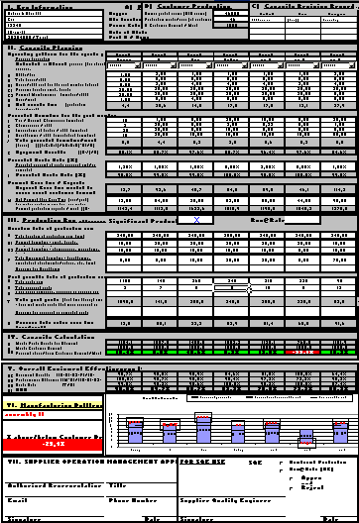
Capacity Assessment Sheet (CAS)
Filling in the file: The CAS file has a second sheet named “CAS user guide”. Please use this user guide when filling in the sections 1 to 7 in the CAS. If an already filled in ICAS file exists for this part number, please use that file as a basis for section 1 & 2 in the CAS.
Fill in volume quoted in RFQ in cell “Annual quoted volume (RFQ)” in section “1. Key Information.” Volume value that should be used is volume in peak production year multiplied with 10% for fluctuations during the year.
Section “3 – Production run” should be filled in according to the results/output of the Significant Prod Run (or later Run@Rate). An agreement needs to be done with Volvo from case to case regarding if the SPR/R@R is required to be done under the supervision of Volvo or can be managed by the supplier themselves

Slide 9
Capacity Assessment Sheet (CAS)
Analysing the result:
In the attached example the row “AA - Percent above/below Customer Demand/Week is red/NOK for one of the assessed processes. (Looking at the result of the SPR/R@R this process will not be able to cover the required weekly customer demand.). For the rest of the processes the result is green/OK. Actions by the supplier will be needed in this red/NOK process to get a totally green/OK result for the whole CAS.
3. Final expected result:
A totally green/OK CAS = All production processes concerned has a capacity planning that is realistic and that has been tested and proven through a Significant Production Run (and later Run@Rate).
A totally green/OK CAS = The supplier has signed off on the offered capacity, manufacturing processes and intended operating pattern to fully produce the required customer volume for the concerned part number (which also satisfies all PPAP requirements).

Slide 10
ICAS – Process flow.
For every part number concerned:
1. RFQ: ICAS template is sent out with RFQ.
2. Supplier: Supplier updates ICAS file with the latest data for the concerned production processes (with attached corrective actions if rejected by Volvo before).
3. ICAS status: Red/NOK or OK (sheet completely filled in and no process step shows lack of capacity).
4. End effect: Supplier has a realistic capacity planning in place to produce the requested Volvo volumes for the concerned part number.
In these APQP-phases:
1. Kick off,. 2. Product design. 3. Process design
(All 3 steps for every phase)
NOK
OK
Next page

Slide 11
CAS – Process flow.
For every part number concerned:
5. SPR/R@R: Depending on the agreement with Volvo the SPR and R@R is performed either under Volvo supervision or under suppliers own supervision.
6. Supplier fills in CAS: Supplier then updates the CAS with the results from the SPR/R@R, signs off and submits it to Volvo (with corrective action list if necessary).
7. Volvo: Volvo approves or rejects the submitted CAS.
8. End effect: All production processes concerned has a capacity planning for the concerned part number that is realistic and that has been tested and proven through a Significant Production Run (and later Run@Rate).
9. Supplier storing: Supplier stores signed off CAS together with PPAP documentation.
In these APQP-phases: 4. Industrialization review. 5. Launch review.
(All 4 steps for every phase)
NOK
OK

Slide 12
Conclusion
After approval of the Capacity Assessment Sheet (CAS) by Volvo at Significant Production Run / Run@Rate, the supplier should continue to use this Capacity Assessment Sheet (CAS) to improve and identify potential capacity issues.
The supplier should at all times communicate immediately about any foreseen capacity issues that could prevent meeting forecasted Volvo volumes or flexibility requirements to his Volvo buyer/SQE.

