Slide 1
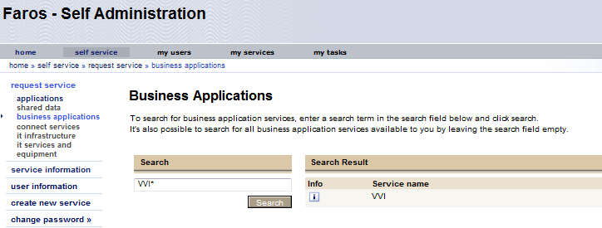
Request for access in Faros
You can find VVI under business applications in Faros.
The VVI-portal is found on the following link; VVI

